Slide 1
ECONOMIC CENSUS DATA

Slide 2
BigData: Big data refer to the massive datasets that are collected from a variety of data source for business needs to reveal new insights for optimized decision making. For Example:
Social Networking
Big Data
Cloud Computing
M
o
B
I
L
e

Slide 3
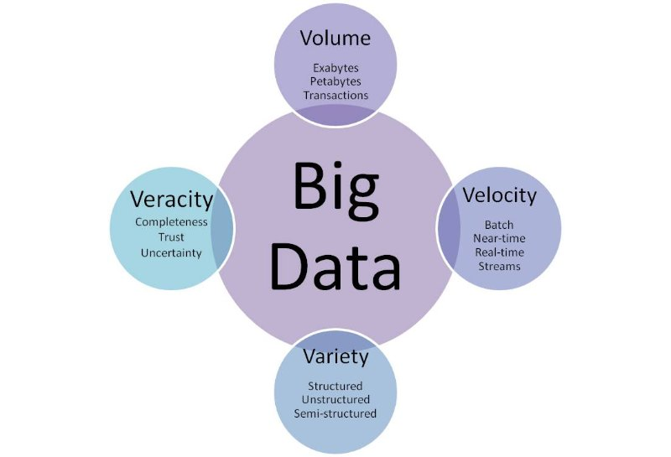
Big Data Characteristics :

Slide 4
BigData: 1.Google - The world’s largest ‘Big Data’ company google processes over 40,000 search queries every second, on average that’s over 3.5 billion searches per day 2.Amazon - Amazon hosts an estimated 1 Exabyte of data across more than 1400000 servers, making it the company with the most number of servers.

Slide 5
Advantages of “BigData” Analytics 1.Scalability 2.Protection against H/W failure 3.Support three types of data

Slide 6
CENSUS DATA SECONDARY TABLE
PIG
FOR HANDLING JSONDATA
MYSQL
FOR CREATING SECONDARY TABLE
SQOOP
FOR IMPOTING SECONDARY TABLE INTO HDFS
MAPREDUCE
Pig
HIVE

Slide 7
Hadoop
Hadoop is a framework that allows distributed processing of large datasets across clusters of commodity hardware using a simple programming model.
Features:
Economic
Easy to use
Distributed Storage
Parallel Processing

Slide 8
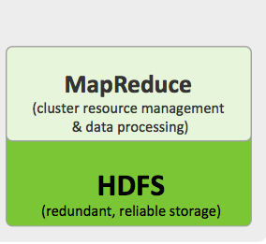
Hadoop Architecture
COMPUTING PART
STORAGE PART

Slide 9
HADOOP ECOSYSTEM 1.MapReduce 2.Hive 3.Pig 4.Hbase 5.Sqoop 6.Zookeeper 7.Flume 8.Oozie

Slide 10
Overview
In the current context the Insurance company has decided to make a more efficient use of its biggest assets :its data. and Big Data is seen as an enabler to get to the objective. In this presentation i am discuss the reasons why Insurance company decided to enter in the Big Data strategy. Big Data have different tools such as Hive, Pig, Hbase, Sqoop, Zookepper, Oozie by using Big Data tools we can measure the economy differently, faster and better.

Slide 11
Project Outline
Title | Economic Census Data
Inputs | Census Data
Data Elements | Age, Education, Marital Status, Gender, Tax Filer Status, Income, Parents, Country of Birth, Citizenship, Weeks Worked.
Analysis Relevance | Education, Social, Finance, Planning, Miscellaneous
Purpose | To conclusion of my Analysed Result for better performance as well as to increase the economic status of LIC company.
Methodology | Agile

Slide 12
Data Dictionary
Census Data :column name
Age
Education
MaritalStatus
Gender
TaxFilerStatus
Income
Parents
CountryOfBirth
Citizenship
WeeksWorked

Slide 13
Continue...
Table for Tax:
T_id,Min_Income,Max_Income,Tax
1,50,2000,5
2,2000,4000,6
3,4000,6000,7
4,6000,8000,8
5,8000,9500,9

Slide 14
Continue:
Table for Pension:
P_id,Min_Income,Max_Income,Pensionper
1,50,2000,60
2,2000,4000,55
3,4000,6000,50
4,6000,8000,45
5,8000,9500,40

Slide 15
Continue
Table for Scholarship:
s_id,parents,subsidy
1,Both Parents Present,0
2,Father Only Present,15000
3,Mother Only Present,20000
4,Neither Parent Present,25000
5,Not In Universe,25000

Slide 16
>Education: 1. Total count of male/female based on education. > select education,gender,count(gender) from social group by education,gender; >Output:

Slide 17
2.Total count of employed/unemployed based on education >2.1. select education,count(weeksworked) from social where weeksworked>=0 group by education; >Output:

Slide 18
>2.2.select education,count(weeksworked) from social where weeksworked=0 group by education; >Output:

Slide 19
3.Total count for people in age range of 18-25 based on education. >select education,count(age) from social where age between 18 and 25 group by education; >Output:

Slide 20
>Planning 1.Voter(s) count in x year(s) > >>census = load '/project/pigcensus/part-m-00000' using PigStorage(',') as (Age,Education,MartialStatus,Gender:bytearray,TaxFilersStatus:bytearray,Income:DOUBLE,Parents,CountryOfBirth,Citizenship,WeeksWorked:INT); >>age = FOREACH census GENERATE Age; >>vote = FILTER age BY Age > 15; >>group_vote = Group vote All; >>count_age = FOREACH group_vote GENERATE COUNT(vote); >>dump count_age; output: (1515)

Slide 21
2.Senior Citizen(s) count in x year(s) >>census = load '/project/pigcensus/part-m-00000' using PigStorage(',') as (Age,Education,MartialStatus,Gender:bytearray,TaxFilersStatus:bytearray,Income:DOUBLE,Parents,CountryOfBirth,Citizenship,WeeksWorked:INT); >>senior_age = FOREACH census GENERATE Age; >>senior_agecount = FILTER senior_age BY Age > 57; >> group_seniorage = Group senior_age All; >>count_senior = FOREACH group_seniorage GENERATE COUNT(senior_agecount); >>dump count_senior; >>output: (306)

Slide 22
3.Total number of Male/Female > To find total number of male and female citizen . > count total male and female for future refrence >>GENDER process: >>census = load '/project/pigcensus/part-m-00000' using PigStorage(',') as (Age,Education,MartialStatus,Gender:bytearray,TaxFilersStatus:bytearray,Income:DOUBLE,Parents,CountryOfBirth,Citizenship,WeeksWorked:INT); >>groupgender = GROUP census BY Gender;

Slide 23
Continue.. >>count = FOREACH groupgender GENERATE group as gender, COUNT(census); >>dump count; >>output: ( Male,939) ( Female,1061)

Slide 24
4.Citizens and immigrants count for employed lot. >>bag1 = FILTER census BY WeeksWorked != 0; >>bag2 = GROUP bag1 BY Citizenship; >>bag3 = FOREACH bag2 GENERATE group as Citizenship, COUNT(bag1); >>dump bag3; >>output; ( Native- Born in the United States,968) ( Foreign born- Not a citizen of U S ,82) ( Native- Born abroad of American Parent(s),12) ( Foreign born- U S citizen by naturalization,43) ( Native- Born in Puerto Rico or U S Outlying,6)

Slide 25
>>Miscellaneous 1.Degree wise count for employability >>The count of employee based on the qualification . >>census = load '/project/pigcensus/part-m-00000' using PigStorage(',') as (Age,Education,MartialStatus,Gender:bytearray,TaxFilersStatus:bytearray,Income:DOUBLE,Parents,CountryOfBirth,Citizenship,WeeksWorked:INT); >>bag1 = FILTER census BY WeeksWorked != 0; >>bag2 = GROUP bag1 BY Education; >>bag3 = FOREACH bag2 GENERATE group as Education, COUNT(bag1); >>dump bag3; >>output:

Slide 27
2.Customer base analysis: > Analysis of the people who are able to buy an insaurance product and satisfy following criteria .analysis the people with respect to their age group that should be below 30,between 31 to 50 and above 50 with their marital status as well as income must be above 2500. >output: 1.age<=30 2. age>31 && age<=50 3.above 50

Slide 31
3.Non-US citizen(s) tax filer status >>To find the tax filer status who doesn’t have citizenship of US. >> census = load '/project/pigcensus/part-m-00000' using PigStorage(',') as (Age,Education,MartialStatus,Gender:bytearray,TaxFilersStatus:bytearray,Income:DOUBLE,Parents,CountryOfBirth,Citizenship,WeeksWorked:INT); >>bag1 = FILTER census By Citizenship MATCHES '.*Foreign born- Not a citizen of U S.*'; >>bag2 = GROUP bag1 BY TaxFilerStatus;

Slide 32
Continue... >>bag3 = FOREACH bag2 GENERATE group as TaxFilersStatus, COUNT(bag1); >>dump bag3; >>output: ( Single,24) ( Nonfiler,36) ( Joint both 65+,1) ( Head of household,6) ( Joint both under 65,68)

Slide 33
4.Country of birth wise count for US citizenship by naturalisation >> census = load '/project/pigcensus/part-m-00000' using PigStorage(',') as (Age,Education,MartialStatus,Gender:bytearray,TaxFilersStatus:bytearray,Income:DOUBLE,Parents,CountryOfBirth,Citizenship,WeeksWorked:INT); >>bag1 = FILTER census By Citizenship MATCHES '.*Foreign born- U S citizen by naturalization.*'; >>bag2 = GROUP bag1 BY CountryOfBirth; >>bag3 = FOREACH bag2 GENERATE group as CountryOfBirth, COUNT(bag1); >>dump bag3; >>output:

Slide 35
>>Social 1.Total amount dispensed on pension in x year(s) > analysis of the total amount for the pension condering after three years >Output: Female,8616.85 Male,8473.099999999999

Slide 36
2.Total amount dispensed on scholarship in current year > select a.age,a.parents,b.s_id,b.subsidy from social a join scolarship b on a.parents = b.parents order by age asc; > insert overwrite local directory '/home/cloudera/Downloads/hive' row format delimited fields terminated by ',' stored as textfile select a.age,a.parents,b.s_id,b.subsidy from social a join scolarship b on a.parents = b.parents order by age asc;

Slide 37
output: 0, Both parents present,2,0 0, Mother only present,3,25000 0, Both parents present,2,0 0, Both parents present,2,0 0, Mother only present,3,25000 0, Both parents present,2,0 >create table scolarship1(age int,parents String,s_id int,subsidy int) row format delimited fields terminated by ',' stored as textfile; >load data local inpath '/home/cloudera/Downloads/hive/hiveop.csv' into table scolarship1;

Slide 38
Continue.. >select parents,count(subsidy) from scolarship1 group by parents; > Both parents present 360 Father only present 17 Mother only present 133 Neither parent present 18 Not in universe 1472

Slide 39
>select parents,sum(subsidy) from scolarship1 group by parents; >Both parents present 0 Father only present 255000 Mother only present 3325000 Neither parent present 540000 Not in universe 44160000 >select sum(subsidy) from scolarship1; >Total MapReduce CPU Time Spent: 15 seconds 290 msec OK 48280000

Slide 40
3.For given age range employable female widowed and divorced count >analysis for the female emplyees whose age is between 30 to 60 followed by their marital status(i.e widowed and divorced) >>AGE,GENDER,MARITAL STATUS,WeeksWorked; >>process: >>create database social; >>use social;

Slide 41
Continue... >>load data local inpath '/home/cloudera/Downloads/part-m-00000' into table social; >>desc social; >>select * from social; >>select maritalstatus, COUNT(maritalstatus) from social where maritalstatus =' Divorced' and gender = ' Female' or maritalstatus = ' Widowed' and age>30 and age<60 group by maritalstatus; >>Output: ( Divorced 70) ( Widowed 13)

Slide 42
> Finance 1.Tax analysis total and gender wise >analysis of the total amount of the tax to be paid by male and female >Output: Female,98288.71000000005 Male,95097.59999999998

Slide 43
2.Per Capita Income(PCI) analysis consolidated,gender wise and category wise >To analysis of the per capital income followed by criteria like age,gender,agegroup. >>census = load '/project/part-m-00000' using PigStorage(',') as (Age,Education,MartialStatus,Gender:bytearray,TaxFilersStatus:bytearray,Income:DOUBLE,Parents,CountryOfBirth,Citizenship,WeeksWorked:INT); >bag1 = foreach census generate Income; >bag2 = group bag1 all;

Slide 44
Continue... >bag3 = foreach bag2 generate SUM(bag1.Income)/COUNT(bag1.Income); >dump bag3; >output: (1727.7615) > agegroup = load '/project/part-m-00000' using PigStorage(',') as (age:INT, category:bytearray ); >bag1 = foreach census generate Income,age; >bag2 = foreach agegroup generate age,category; > bag3 = join bag1 by age,bag2 by age;

Slide 45
Continue.. > bag4 = foreach bag3 generate category,Income; > bag5 = group bag4 by category; > bag6 = foreach bag5 generate group,SUM(bag4.Income)/COUNT(bag4.Income); >dump bag6; >output: (adult,1828.3665283540802) (elderly,1821.6470588235295) (infants,1631.7329974811082) (Teenager,1758.4202898550725) (middle-aged,1671.4414225941423) (senior citizen,1662.03913043 47827)

Slide 46
CONCLUSION The general consensus is that Big Data will be used far more in the future. From the life insurer’s perspective, there is a sense that the life insurance industry must use Big Data to survive. There is enough evidence from other sectors that customer intelligence and tailoring is increasing productivity and profitability and the same benefits could be realised for the life insurance industry. Big Data is at the heart of a dynamic, customer-focused life insurance industry for the future.

Slide 47
Thank You!!!

